Slide 1
Factors Affecting Parent and Student Satisfaction of New York City Public High Schools
Kara and Sara Johnson
CS 5963 – Introduction to Data Science
Final Project
Notes:
Education is an important piece of our society and is integral for the development and success of many citizens of the US. However, the quality of education and school environmental factors are key for productive learning and overall student success rate. This data science project was to identify factors affecting parent and student satisfaction of New York City public high schools, which is one of the largest public school systems in the country.

Slide 2

New York City Schools Data
NYC Dept. of Education 2015-16 School Survey
436 High Schools
Collects responses from parents and students
pertaining to the following variables:
% Satisfaction with 'Collaborative Teachers’
% Satisfaction with 'School Leadership’
% Satisfaction with 'Rigorous Instruction'
% Satisfaction with 'Family-Community Ties’
% Satisfaction with 'Supportive Environment’
% Satisfaction with 'Trust’
% Overall Parent Satisfaction
% Overall Student Satisfaction
Notes:
The New York City Department of Education releases the annual results of their NYC School Survey, which is distributed at 436 high schools. This survey collects responses from parents and students pertaining to ^^^LIST OF VARIABLES^^^.

Slide 3
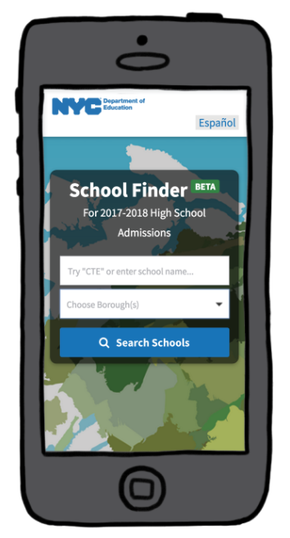
New York City Schools Data
NYC “High Schools At a Glance” Dataset
Tool mostly used by parents for choosing schools
based on a number of factors:
Borough
Number of Programs
Neighborhood
Graduation Rate
Attendance Rate
% Students who feel safe
AP Courses
CTE Programs
Notes:
Additionally, New York City has made the “High Schools At a Glance” dataset, which provides data mostly for a tool used by parents for choosing schools based on a number of factors, such as ^^LIST OF VARIABLES^^. These variables give insight on key statistics on these schools.

Slide 4
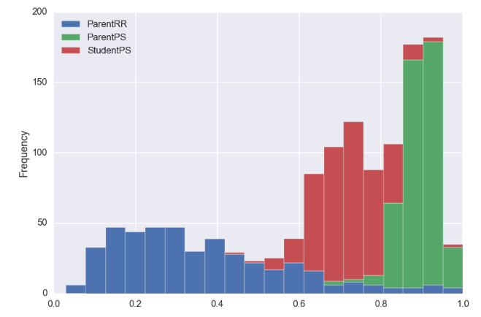
Overall Satisfaction with School
Notes:
From the NYC School Survey, we explored the distributions of the parent response rate (in blue), parent percent satisfaction (in green), and student percent satisfaction (in red). While there is a relatively broad distribution in student satisfaction between 40-90%, the parent satisfaction is a tight curve between 80-100%.
When we considered both the high minority and high poverty rates combined with this disparity in student and parent satisfaction, we decided to ask some questions about the relationships between environmental and educational factors, parent and student satisfaction, and socioeconomics, demographics, and geographic location.

Slide 5
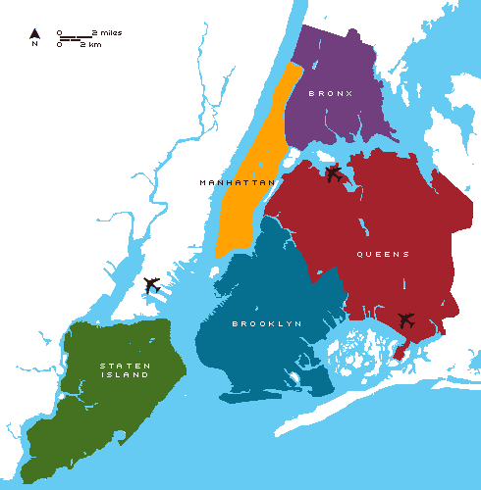
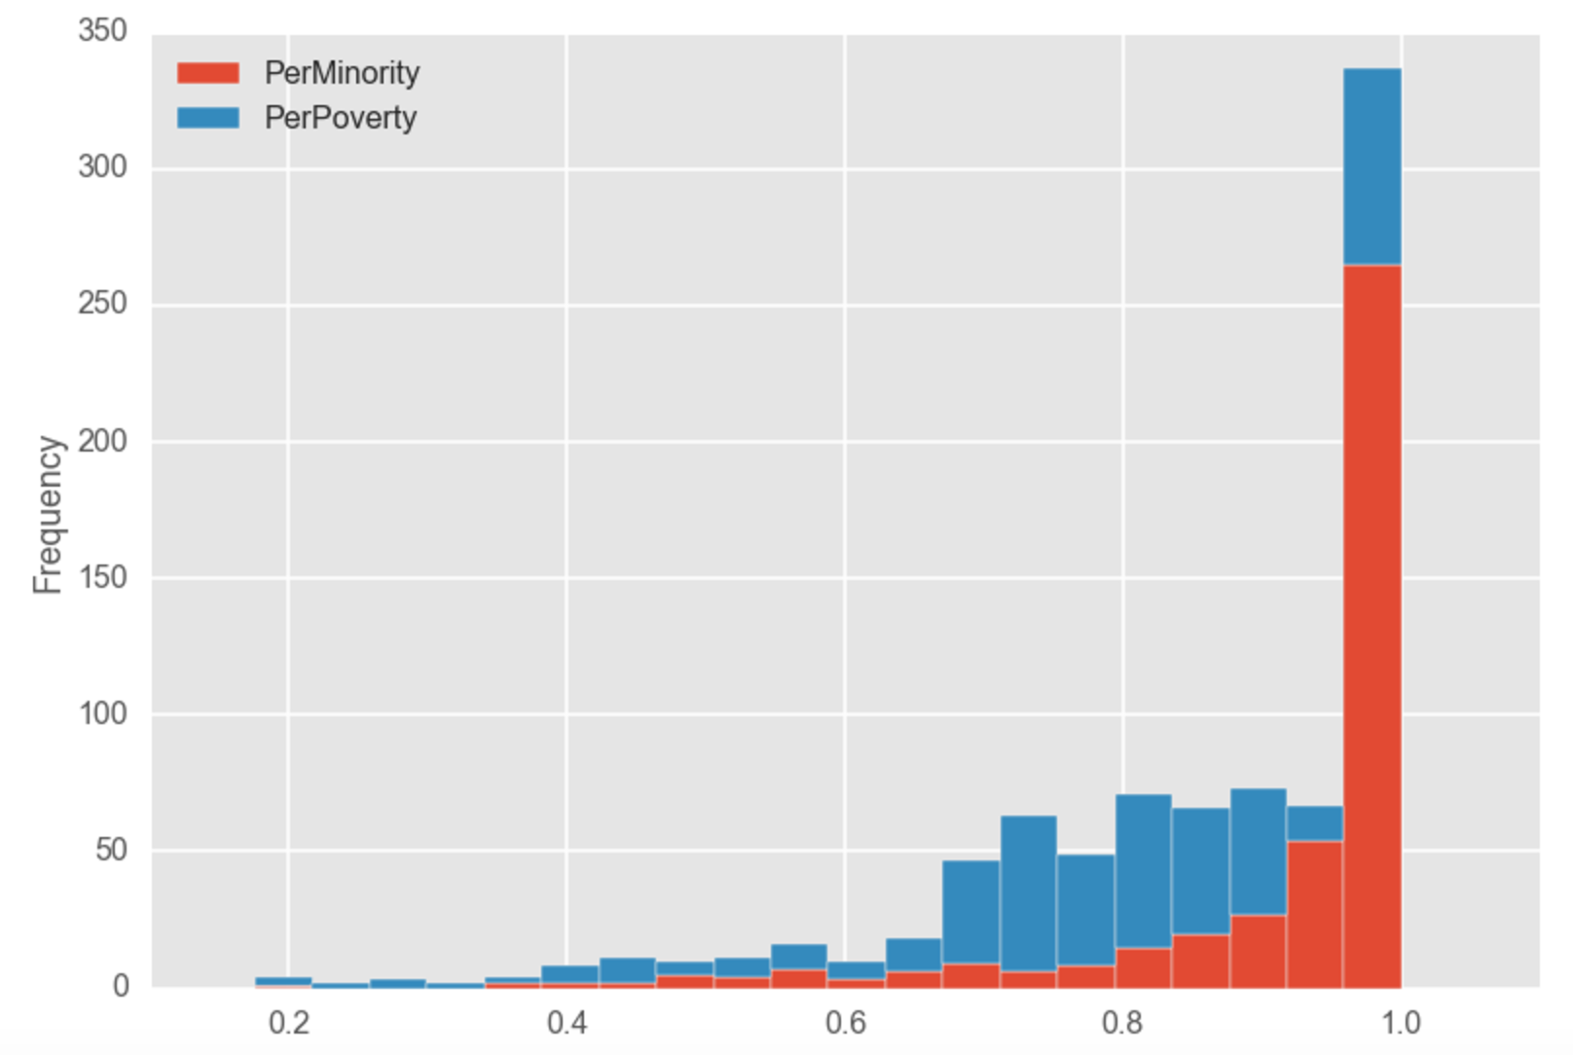
Demographics, Socioeconomics and Geography
Notes:
Additionally, we integrated demographic and socioeconomic information, including the percent of minority students (in orange) and the percent of students considered to be in poverty based on their parents income (in blue). The distribution of these variables show that the high schools in New York City are highly diverse and a high percentage of their students are in poverty. When we considered both the high minority and high poverty rates combined with this disparity in student and parent satisfaction, we decided to ask some questions about the relationships between environmental and educational factors, parent and student satisfaction, and socioeconomics, demographics, and geographic location.

Slide 6
Objective 1: Identify factors important to students versus parents
Multilinear Regression
STUDENTS
PARENTS
Trust
Collaborative Teachers
Supportive Environment
Trust
School Leadership
Family-Community Ties
R² = 0.976
R² = 0.763
Notes:
Our first objective was to identify which educational factors are most important to students versus parents. We first performed multilinear regression to find the combination of variables that best correlated to overall student satisfaction. We found that the factors most important to students were: Trust, Collaborative Teachers, and Supportive Environment.
We then repeated this to find the factors most important to parents, which were Trust, School Leadership, and Family-Community Ties.

Slide 7
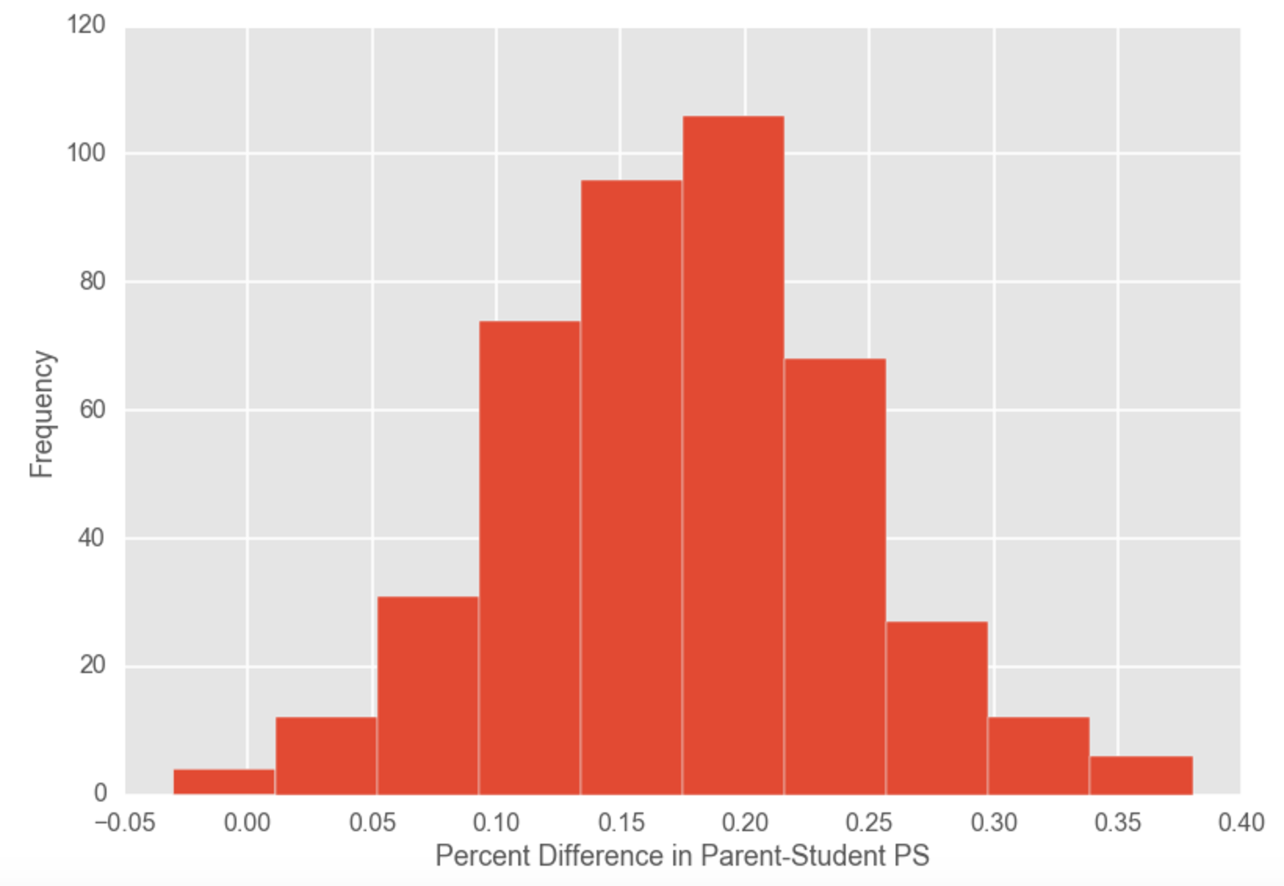
Objective 3: What factors best predict differences in student and parent satisfaction?
Classification
(K-NN)
“Small
Difference”
“Large Difference”
Notes:
Next we wanted to determine if we could accurately predict schools with a large difference in student and parent satisfaction. In order to investigate, we used k-Nearest Neighbors classification to see if we could classify whether the school has a ”Small difference” or a ”large difference” in parent versus student percent satisfaction.

Slide 8
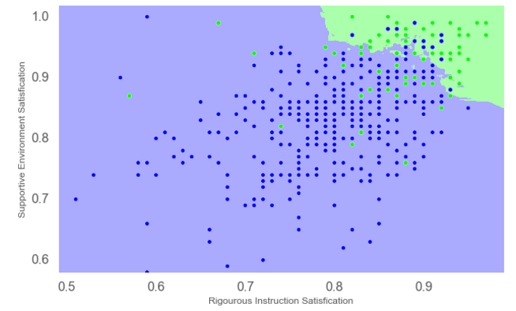
Objective 3: What factors best predict differences in student and parent satisfaction?
Rigorous Instruction
Student Safety
Confusion Matrix | Correct | Incorrect
Small Difference | 41 | 40
Large Difference | 15 | 340
Notes:
We found that two factors in particular best predict the disparity in student and parent satisfaction: rigorous instruction and student safety. This implies that parents and students may have different perceptions of whether the school has rigorous enough instruction or whether the school is safe.

Slide 9
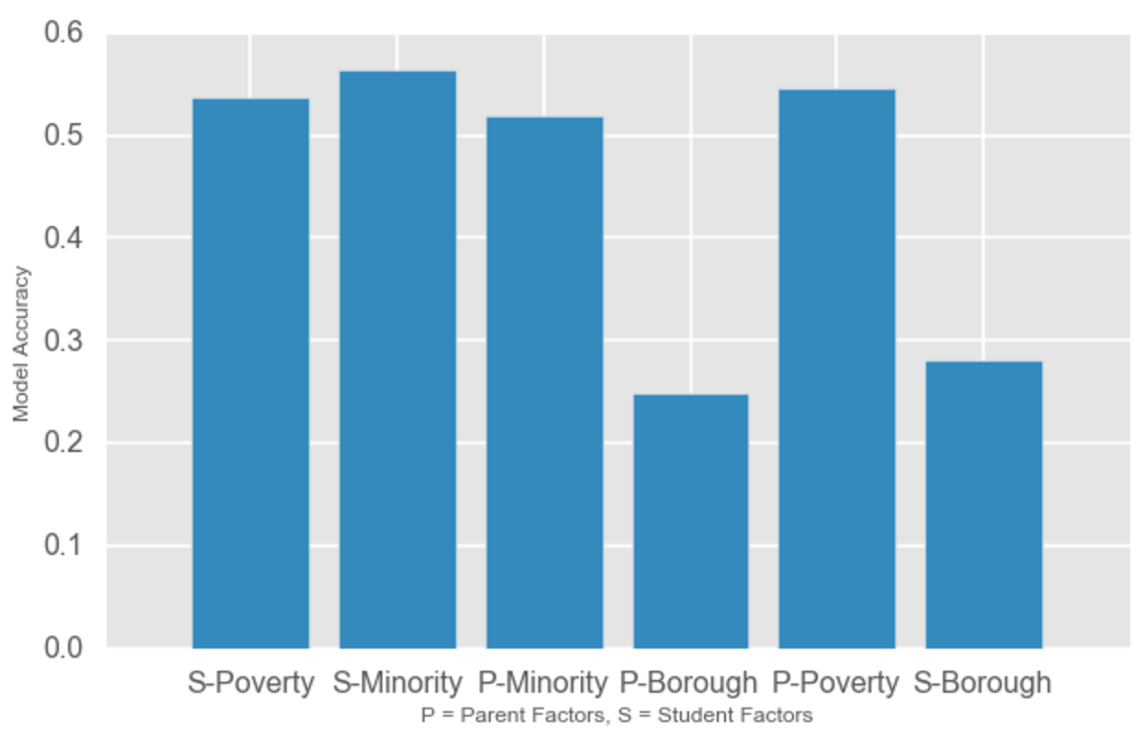
Objective 2: Do factors important to students or parents best predict minority, poverty, or borough?
Classification
(K-NN)
Notes:
Finally, based the regression results, we were interested to see if factors important to students versus parents best predict minority, poverty, or borough of these high schools. We performed k-Nearest Neighbors classification to build multiple models using either the parent factors or the student factors.
We found that both the parent and student factors were least accurate in predicting borough, while the the factors more accurately predicted poverty and minority. Overall, the best classification model was predicting schools’ percent minority using the factors important to students, indicating that student satisfaction is more impacted by minority and poverty levels than borough, and that factors important to students have a more direct influence on overall satisfaction.

Slide 10
Demographics, Socioeconomics and Geography
Notes:
Therefore, the demographics of a particular school are a better predictor of both student and parent satisfaction than the borough the borough the school is located in. These findings, as well as the identified factors important to student and parent satisfaction in NYC schools, may be translatable to many public school systems in the US, particularly in other large and diverse communities.

